Slide 1

Django – User Management
Django Example

Slide 2
Information
Agenda
System
01
System Architecture
System Architecture Diagram
02
CRUD for users
A few ways to access the data
03
Review System Architecture
Review the Diagram

Slide 3
You will learn to
System Architecture
CRUD for users
User registration
User detail list
User update
User delete

Slide 4
System Architecture
Start with Database

Slide 5
System Architecture
The conceptual model that defines the structure, behavior, and more views of a system.
A system architecture diagram would be used to show the relationship between different components.
Usually they are created for systems which include hardware and software and these are represented in the diagram to show the interaction between them.
However, it can also be created for web applications.
In the web programming (using Django), it consists of MVT concepts.

Slide 6
System Architecture (CRUD Example)
Request
urls.py
views.py
Model
member_delete_confirm.html
Member Deletion
delete_member
Member Update
update_member
Member
member_form.html
Browser
Member Insertion
create_member
list_members
list_members.html
Member Detail List
Response
USER MANAGEMENT
USER SETTING
View
Controller
Model

Slide 7
The order of Code
Check Previous Section
The order of code | Related command / file | Contents of the code
Framework coding | Start project | The new project creation
 | settings.py | Project setting modification
 | migrate | User / group table creation
 | createsuperuser | Project admin super-user creation
 | startapp | User Management app production
 | settings.py | User Management app registration
Model coding | models.py | Model / Table definition
 | admin.py | Admin site model registration
 | makemigrations | Model modification commit
 | migrate | Any modification execution
View coding | views.py | View logic registration
URLconf coding | urls.py | URL definition
Template coding | templates directory | Web files creation
Framework Coding
Model Coding
This Section

Slide 8
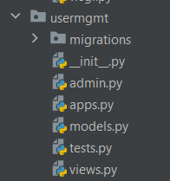
e. Start app
1. Framework coding
1.
python manage.py startapp usermgmt
Create a new app “usermgmt”
Type:
It will show a new folder with a list of Python files (admin, apps, models, tests, and views)
usermgmt: user management

Slide 9
f. Setting the new app
1. Framework coding
Go to “settings.py”
Add a new INSTALLED_APPS
INSTALLED_APPS = [ 'django.contrib.admin', 'django.contrib.auth', 'django.contrib.contenttypes', 'django.contrib.sessions', 'django.contrib.messages', 'django.contrib.staticfiles', 'faq.apps.FaqConfig',
'usermgmt.apps.UsermgmtConfig', ]

Slide 10
a. models
2. Model coding
Create model / table definition
In the folder “usermgmt", Open “models.py”
models.py
from django.db import models
class Member(models.Model):
salutation = models.CharField(max_length=10)
first_name = models.CharField(max_length=30)
last_name = models.CharField(max_length=40)
email = models.EmailField()
Entity Relationship Diagram (ERD)
Member
salutation: CharField(10)
first_name: CharField(30)
last_name: CharField(40)
email: EmailField()

Slide 11
b. admin
2. Model coding
Insert the code below to "admin.py" in the folder "usermgmt"
admin.py
from django.contrib import admin
from .models import Member
admin.site.register(Member)

Slide 12
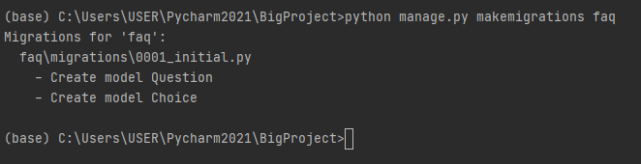
c. makemigrations
2. Model coding
Since there are some changes on the database, we need to migrate again.
Before doing the migration, we need to run “makemigrations”
python manage.py makemigrations usermgmt

Slide 13
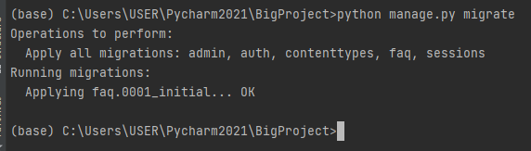
d. migrate
2. Model coding
Lastly, do “migrate” to put all contents into the Django environment.
python manage.py migrate

Slide 14
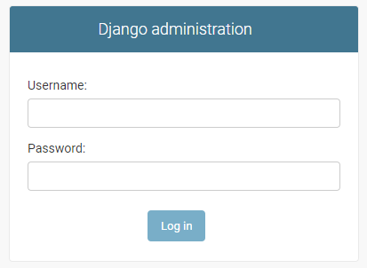
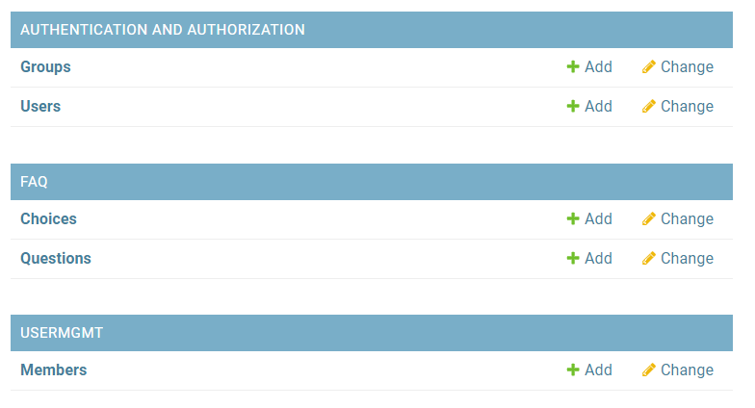
Run the program
2. Model coding
Run the project “BigProject”
Go to the link for admin
Input your data:
Username: user
Password: hufsime203
http://127.0.0.1:8000/admin/

Slide 15
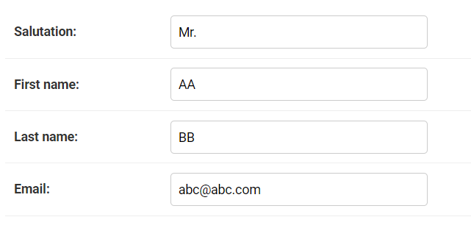
Add 1 data
1.
Insert 1 data

Slide 16
View – URL - Template Coding

Slide 17
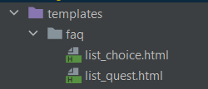
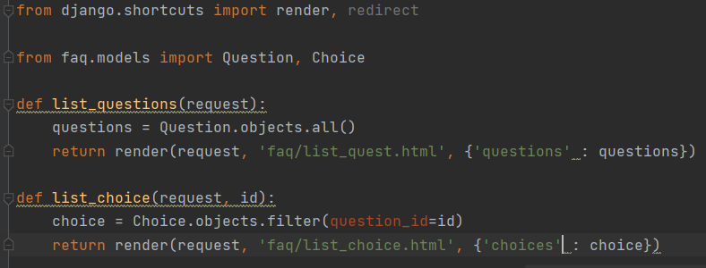
Adjusting the folder
The previous example was about ‘faq’.
Create a folder ‘faq’ inside the folder ‘templates.
Move the ‘list_choice.html’ and ‘list_quest.html’ into the ‘faq’ folder.
After you moved the HTML files, it will change the views.py automatically

Slide 18
View coding
views.py
urls.py
HTML
In the "views.py" (folder ‘usermgmt'), write a function as below
from django.http import HttpResponseRedirect
from django.shortcuts import render, redirect
from usermgmt.models import Member
def list_members(request):
members = Member.objects.all()
return render(request, 'usermgmt/list_members.html', {'members' : members})

Slide 19
Create a new URL file in the sub-folder
views.py
urls.py
HTML
In the folder "usermgmt", create a new file “urls.py".
from django.urls import path
from usermgmt import views
urlpatterns = [
path('', views.list_members, name = 'list_members'),
]

Slide 20
URLconf Coding
views.py
urls.py
HTML
Add the code in the "urls.py" (in the parent folder)
from django.contrib import admin
from django.urls import path, include
urlpatterns = [
path('admin/', admin.site.urls),
path('faq/', include('faq.urls')),
path('member/', include('usermgmt.urls')),
]
Call the urls.py in the apps “usermgmt" when the user click the URL /member

Slide 21
Create HTML file
views.py
urls.py
HTML
Create HTML file name "list_members.html" in the folder "templates".
<html>
<body>
<h1><center>Member List</center></h1>
<div class="container">
<table class="table table-striped">
<tr>
<th>ID </th>
<th>Salutation</th>
<th>First Name</th>
<th>Last Name</th>
<th>Email</th>
</tr>
<tr>
{% for member in members%}
<td> {{ member.id }} </td>
<td> {{ member.salutation }}</td>
<td> {{ member.first_name }}</td>
<td> {{ member.last_name }}</td>
<td> {{ member.email }}</td>
</tr>
{%endfor%}
</table>
<link rel="stylesheet" href="https://maxcdn.bootstrapcdn.com/bootstrap/3.3.7/css/bootstrap.min.css">
</div>
</body>
</html>

Slide 22
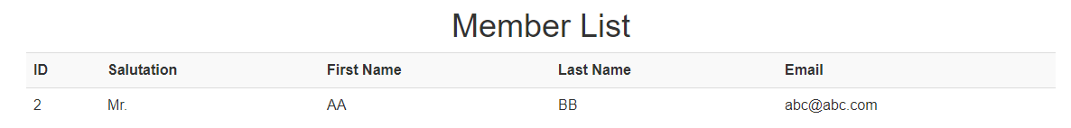
Run your Django
http://127.0.0.1:8000/member/

Slide 23
Explanation
In the "views.py", we use render() instead of get_template() as an alternative.
There are two additional aspects that we learn from the example; Forms and Design
Forms
A class MemberForm is necessary to automatically build the form according to the built-in model.
To connect to the model, it is required to build the class Meta.

Slide 24
Explanation
Design
For simplification, we use CDN (content delivery network). CDN is a geographically distributed network of proxy servers and their data centers.
In this example, we utilize the CDN of bootstrap
Since we use bootstrap, we need to understand the basic concept of bootstrap.
https://maxcdn.bootstrapcdn.com/bootstrap/3.3.7/css/bootstrap.min.css"

Slide 25
Explanation
Bootstrap: The most popular front-end framework for developing responsive, mobile first projects on the web
Bootstrap CDN is a free and public content delivery network.
Using bootstrap, we can append the HTML tag attribute (using class) following the structure of the bootstrap.
For example,
<table class="table table-striped">

Slide 26
Explanation
More info about bootstrap:
https://getbootstrap.com/docs/3.3/getting-started/
https://www.w3schools.com/bootstrap/bootstrap_get_started.asp

Slide 27
CRUD for users
CREATE

Slide 28
Create a ModelForm
In the folder "usermgmt", create a new file "forms.py".
from django import forms
from usermgmt.models import Member
class MemberForm(forms.ModelForm):
class Meta:
model = Member
fields = '__all__'
#field = ['salutation', 'first_name', 'last_name', 'email']

Slide 29
Create new member
views.py
urls.py
HTML
In the 'views.py' (in the folder 'usermgmt'), add a new function
from usermgmt.forms import MemberForm
def create_member(request):
form = MemberForm(request.POST or None)
if form.is_valid():
form.save()
return redirect('list_members')
return render(request, 'usermgmt/member_form.html', {'form' : form})

Slide 30
Create a new link to the new function
views.py
urls.py
HTML
Update the file 'urls.py' at the folder "usermgmt".
Pay attention to the name.
from django.urls import path
from usermgmt import views
urlpatterns = [
path('', views.list_members, name = 'list_members'),
path('new/', views.create_member, name = 'add_member'),
]

Slide 31
Append a line in the list_member.html
views.py
urls.py
HTML
<html>
<body>
<h1><center>Member List</center></h1>
<div class="container">
<table class="table table-striped">
<tr>
<th>ID </th>
<th>Salutation</th>
<th>First Name</th>
<th>Last Name</th>
<th>Email</th>
</tr>
<tr>
{% for member in members%}
<td> {{ member.id }} </td>
<td> {{ member.salutation }}</td>
<td> {{ member.first_name }}</td>
<td> {{ member.last_name }}</td>
<td> {{ member.email }}</td>
</tr>
{%endfor%}
</table>
<a class="btn btn-info pull-right" href = "{%url 'add_member' %}"> New Member </a>
<link rel="stylesheet" href="https://maxcdn.bootstrapcdn.com/bootstrap/3.3.7/css/bootstrap.min.css">
</div>
</body>
</html>
Add this line to the HTML file

Slide 32
Create a new HTML file
views.py
urls.py
HTML
Create a file "member_form.html" in the folder "templates/usermgmt".
<html>
<body>
<div class="container">
<h1> New / Update Member</h1>
<form method="POST">
{% csrf_token %}
<label>Salutation</label> {{ form.salutation}} </br>
<label>First Name</label> {{ form.first_name}} </br>
<label>Last Name</label> {{ form.last_name }} </br>
<label>Email</label> {{ form.email }} </br>
<button class="btn btn-default" type="submit">Save</button>
<button onclick="window.history.back();" class="btn btn-default" type="button">Cancel</button>
</form>
</div>
<link rel="stylesheet" href="https://maxcdn.bootstrapcdn.com/bootstrap/3.3.7/css/bootstrap.min.css">
</body>
</html>

Slide 33
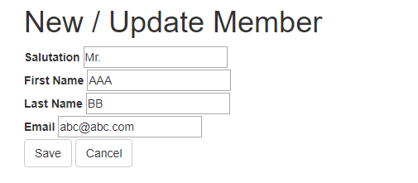
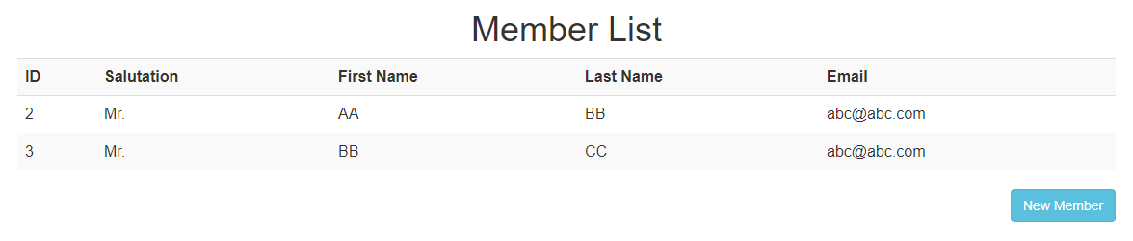
Run

Slide 34
Explanation
Form
form = MemberForm(request.POST or None) is a line to create an object when a "submit" is requested.
is_valid is a function that return boolean (true/false) to confirm that a form is valid or not. A form is not valid if the contents do not satisfy the input criteria. For example, email does not contain @
form.save() is a function to execute the form and submit the data in the form into particular functions.
redirect() is a function to execute a HTML file according to the name.

Slide 35
Explanation
To execute another URL, we can use the statement "url" and write the address "name" as specified in the urls.py
The site generates a unique token when it makes the form page. This token is required to post/get data back to the server.
Since the token is generated by your site and provided only when the page with the form is generated, some other site can't mimic your forms -- they won't have the token and therefore can't post to your site.
href = "{%url 'add_member' %}"
{% csrf_token %}
Cross-Site Request Forgery (CSRF)

Slide 36
Explanation
This is a simple Javascript to return to the previous page without any submission.
“Onclick” is a statement in Javascript to execute a function whenever an element (e.g., button) is clicked.
onclick="window.history.back();"

Slide 37
CRUD for users
UPDATE

Slide 38
Create a new function to update member
views.py
urls.py
HTML
Append function "update_member" in the file "views.py".
def update_member(request, id):
member = Member.objects.get(id = id)
form = MemberForm(request.POST or None, instance = member)
if form.is_valid():
form.save()
return redirect('list_members')
return render(request, 'usermgmt/member_form.html', {'form' : form, 'member' : member})

Slide 39
Create a new link to the new function
views.py
urls.py
HTML
Update the file 'urls.py' at the folder "usermgmt".
from django.urls import path
from usermgmt import views
urlpatterns = [
path('', views.list_members, name = 'list_members'),
path('new/', views.create_member, name = 'add_member'),
path('update/<int:id>/', views.update_member, name = 'update_member'),
]

Slide 40
Update list_member.html
views.py
urls.py
HTML
<html>
<body>
<h1><center>Member List</center></h1>
<div class="container">
<table class="table table-striped">
<tr>
<th>ID </th>
<th>Salutation</th>
<th>First Name</th>
<th>Last Name</th>
<th>Email</th>
<th> Update </th>
</tr>
<tr>
{% for member in members%}
<td> {{ member.id }} </td>
<td> {{ member.salutation }}</td>
<td> {{ member.first_name }}</td>
<td> {{ member.last_name }}</td>
<td> {{ member.email }}</td>
<td> <a class="btn btn-info" href ="{%url 'update_member' member.id %}" >Update </a> <td>
</tr>
{%endfor%}
</table>
<a class="btn btn-info pull-right" href = "{%url 'add_member' %}"> New Member </a>
<link rel="stylesheet" href="https://maxcdn.bootstrapcdn.com/bootstrap/3.3.7/css/bootstrap.min.css">
</div>
</body>
</html>
Adding these two lines

Slide 41
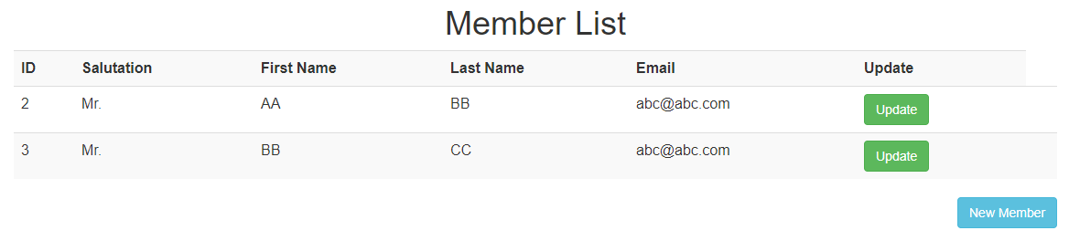
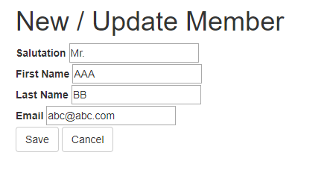
Run
In some cases, you cannot run the “Update Member” before you create the “delete”
URL and function

Slide 42
Explanation
It is necessary to forward the instance to the form. In this case, the instance is the object "member".
In order to open the member_form.html, it is necessary to forward the member ID.
form = MemberForm(request.POST or None, instance = member)
href ="{%url 'update_member' member.id %}"

Slide 43
CRUD for users
DELETE

Slide 44
Create a new function to delete member
views.py
urls.py
HTML
Append function "delete_member" in the file "views.py".
def delete_member(request, id):
member = Member.objects.get(id = id)
if request.method == 'POST':
member.delete()
return redirect('list_members')
return render(request, 'usermgmt/member_delete_confirm.html', {'member' : member})

Slide 45
Create a new link to the new function
views.py
urls.py
HTML
Update the file 'urls.py' at the folder "usermgmt".
from django.urls import path
from usermgmt import views
urlpatterns = [
path('', views.list_members, name = 'list_members'),
path('new/', views.create_member, name = 'add_member'),
path('update/<int:id>/', views.update_member, name = 'update_member'),
path('delete/<int:id>/', views.delete_member, name = 'delete_member'),
]

Slide 46
Update HTML file
views.py
urls.py
HTML
Update a file "member_form.html" in the folder "template".
<html>
<body>
<div class="container">
<h1> New / Update Member</h1>
<form method="POST">
{% csrf_token %}
<label>Salutation</label> {{ form.salutation}} </br>
<label>First Name</label> {{ form.first_name}} </br>
<label>Last Name</label> {{ form.last_name }} </br>
<label>Email</label> {{ form.email }} </br>
<button class="btn btn-default" type="submit">Save</button>
<button onclick="window.history.back();" class="btn btn-default" type="button">Cancel</button>
</form>
{% if member %}
<a class="btn btn-danger" href="{%url 'delete_member' member.id %}">Delete</a>
{%endif%}
</div>
<link rel="stylesheet" href="https://maxcdn.bootstrapcdn.com/bootstrap/3.3.7/css/bootstrap.min.css">
</body>
</html>
Add three lines in the HTML file

Slide 47
Create member_delete_confirm.html
views.py
urls.py
HTML
Create the member_delete_confirm.html in the folder "templates".
<html>
<body>
<form method="post">
{% csrf_token %}
<h2> Are you sure to remove {{ member.first_name }}</h2>
<button class="btn btn-danger" type="submit">Delete</button>
<button onclick="window.history.back();" class="btn btn-default" type="button">Cancel</button>
</form>
<link rel="stylesheet" href="https://maxcdn.bootstrapcdn.com/bootstrap/3.3.7/css/bootstrap.min.css">
</body>
</html>

Slide 48
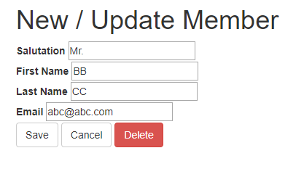
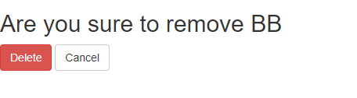
Run

Slide 49
Explanation
This line shows a link to delete_member given the member ID.
href="{%url 'delete_member' member.id %}"

Slide 50
System Architecture (CRUD Example) - revisited
Request
urls.py
views.py
Model
member_delete_confirm.html
Member Deletion
delete_member
Member Update
update_member
Member
member_form.html
Browser
Member Insertion
create_member
list_members
list_members.html
Member Detail List
Response
USER MANAGEMENT
USER SETTING
Template
Views
Model

Slide 51
Summary
System Architecture
CRUD for user management system
Member registration
Member detail list
Member update
Member delete

